Slide 1
Advanced Topics

Slide 2
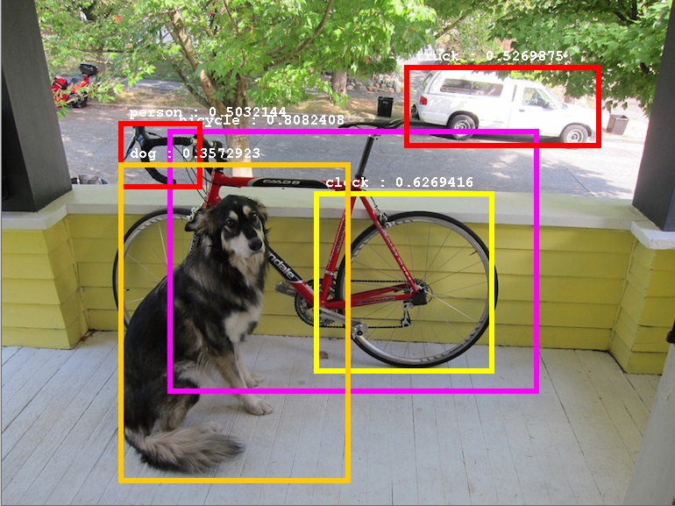
YOLO
YOLO is a state-of-the-art object detection model in computer vision.
Unlike traditional methods that require multiple passes over an image, YOLO performs real-time object detection in a single pass, making it incredibly fast.
It divides an image into a grid and predicts bounding boxes and class probabilities for objects within each grid cell.

Slide 3
YOLO (1/3)
YOLO is just a CNN with a specific depth of the output tensor
P_{o}
CNN
X
Y
Image
H
W
C₀
···
C_{N}

Slide 4
YOLO (2/3)
P_{o}
Object Detection Task (binary logistic regression)
X
Y
Object Localization Task (numerical regression)
H
W
C₀
···
Object Classification Task (logistic regression)
C_{N}

Slide 5
Non-Maximum Suppression
Non-Maximum Suppression (NMS) is a technique in computer vision used to filter out redundant bounding boxes in object detection tasks.
It keeps only the most relevant bounding boxes by suppressing those with lower confidence scores or significant overlap with others.
NMS

Slide 6
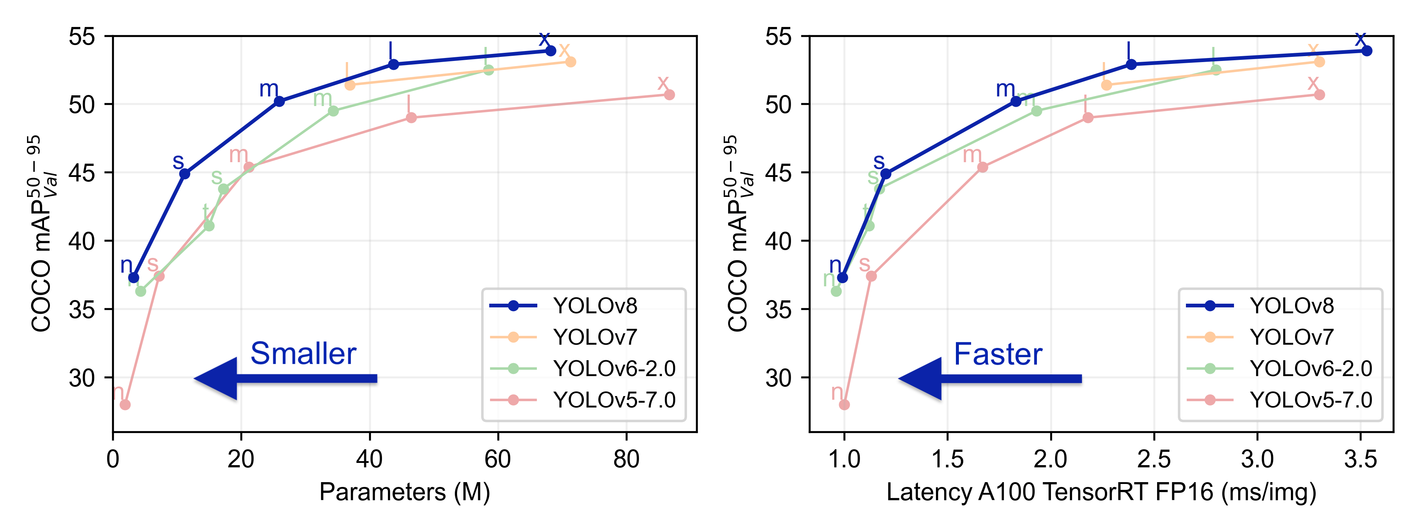
YOLOv8 (3/3)
Last version of the YOLO architecture released in 2023

Slide 7
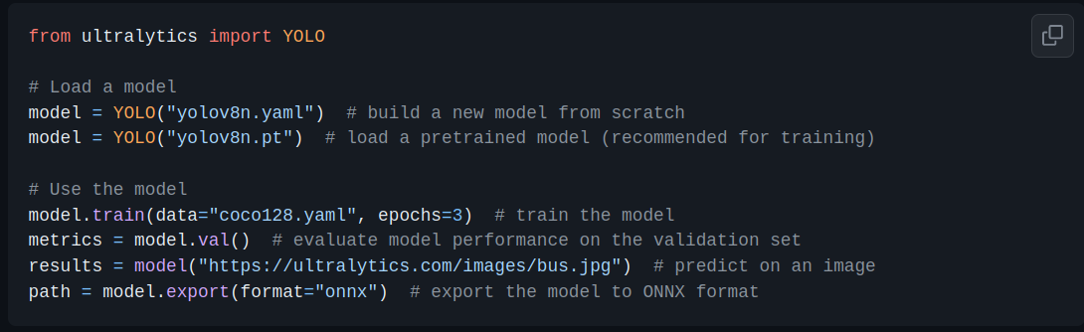
YOLOv8: Implementation
A very famous and well-maintained implementation of YOLOv8 is ultralytics. it has significantly contributed to the YOLO object detection framework by providing an efficient and user-friendly implementation of YOLOv8.

Slide 8
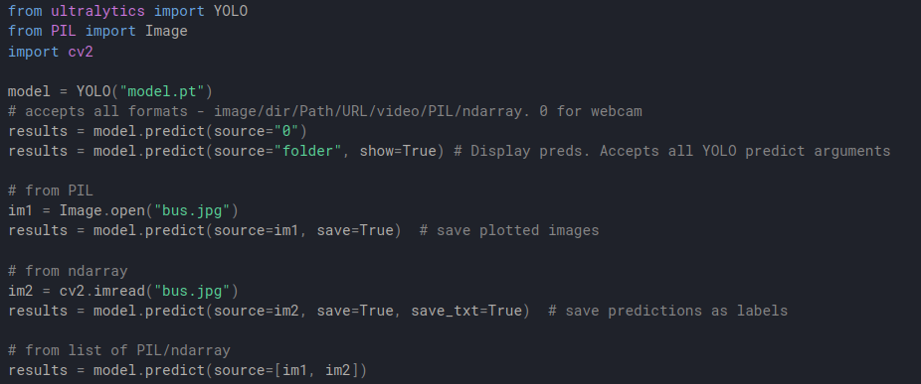
YOLOv8: Inference

Slide 9
Faster R-CNN
Faster R-CNN is a deep learning framework for object detection.
It combines a Region Proposal Network (RPN) with a CNN to efficiently generate region proposals and classify objects within those regions.
CNN
Region Proposal Network
Image
Classifier
Pooler

Slide 10
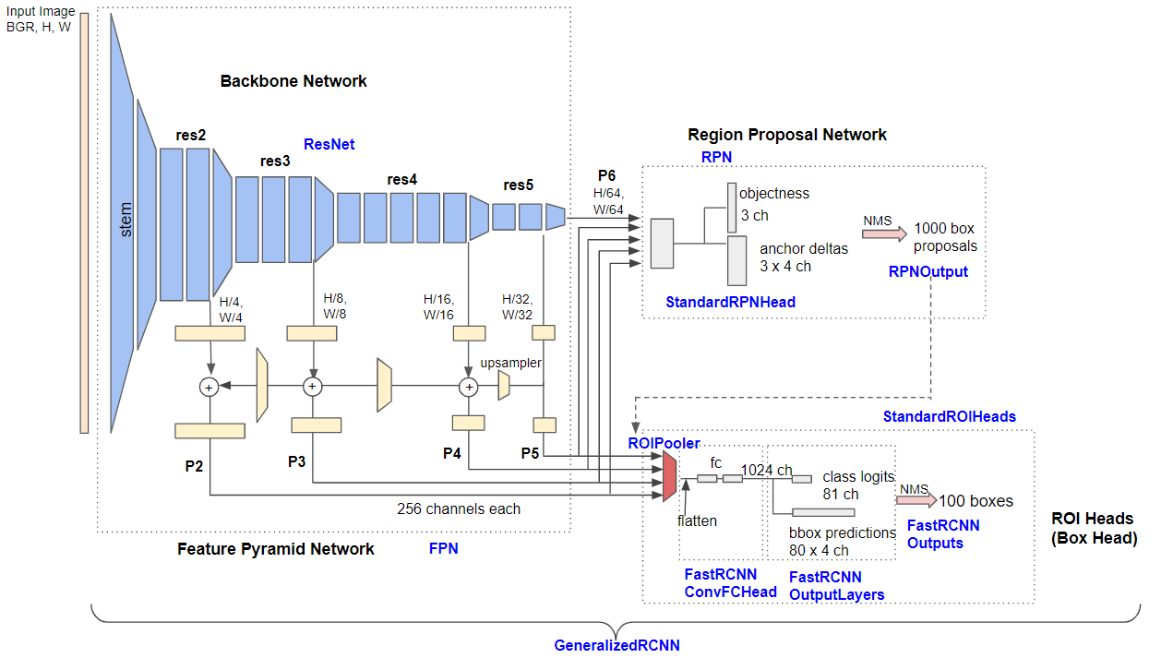
Faster R-CNN: Architecture

Slide 11
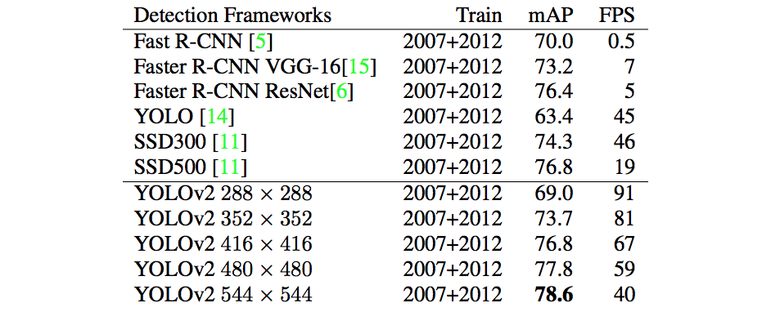
Faster R-CNN vs YOLO

Slide 12
Faster R-CNN: Detectron2
Detectron2 is a popular deep learning framework for object detection and segmentation tasks. Developed by Facebook AI Research (FAIR), it builds upon the original Detectron framework and provides a more modular and flexible architecture.

Slide 13
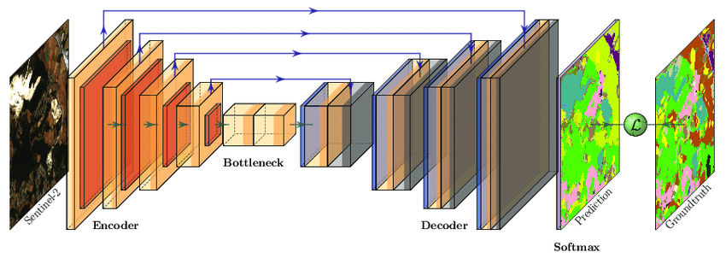
UNET
U-Net is a convolutional neural network architecture designed for semantic image segmentation tasks.
Its distinctive U-shaped architecture allows it to capture fine-grained details while maintaining spatial information.
U-Net has been widely used in medical image analysis and other fields where precise image segmentation is required.

Slide 14
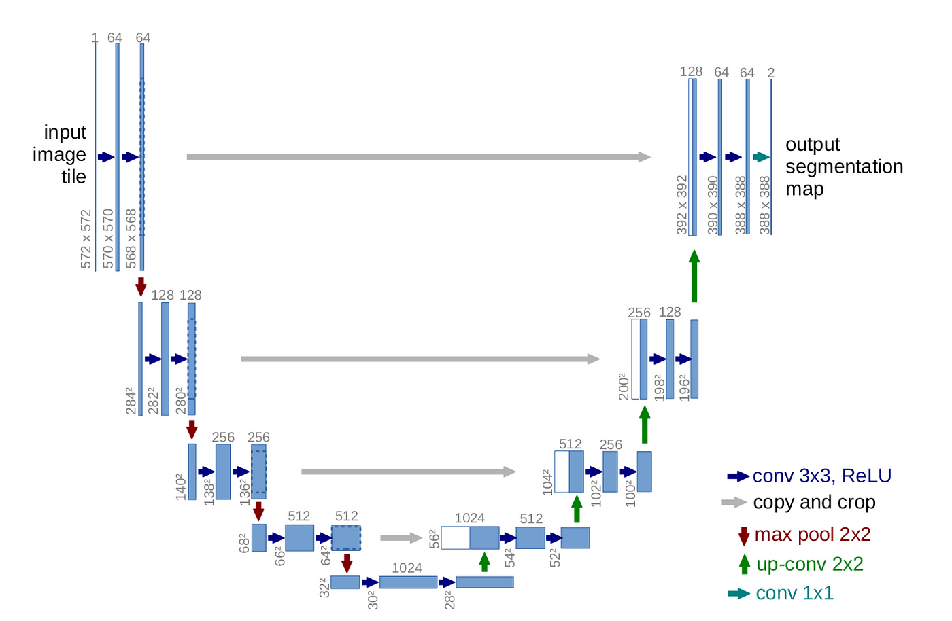
UNET: Architecture
It consists of a U-shaped structure with two main parts: an encoder (the contracting path) and a decoder (the expansive path)

Slide 15
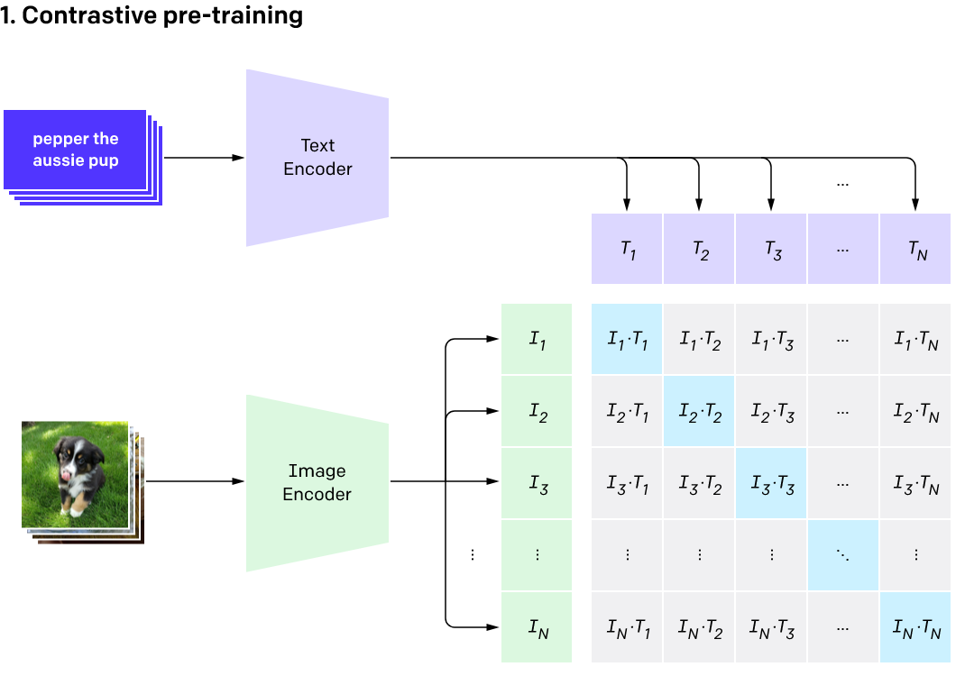
CLIP
CLIP is a deep learning model developed by OpenAI that stands for "Contrastive Language-Image Pretraining."
It combines vision and language by learning to associate images and text in a way that allows it to perform a wide range of tasks, including image classification and natural language understanding, without task-specific training.

Slide 16
CLIP: Architecture
CLIP is composed of two neural networks: an image encoder and a text encoder. These two encoders work together to enable the model's cross-modal understanding of images and text.
img₀
if₀
if₁
if₂
softmax
over
rows
img₁
Image
Encoder
img₂
tf₀
d(tf₀,if₀)
d(tf₀,if₁)
d(tf₀,if₂)
Images and text pairs
txt₀
tf₁
d(tf₁,if₀)
d(tf₁,if₁)
d(tf₁,if₂)
txt₁
Text
Encoder
softmax
over
columns
tf₂
d(tf₂,if₀)
d(tf₂,if₁)
d(tf₁,if₂)
txt₂

Slide 17
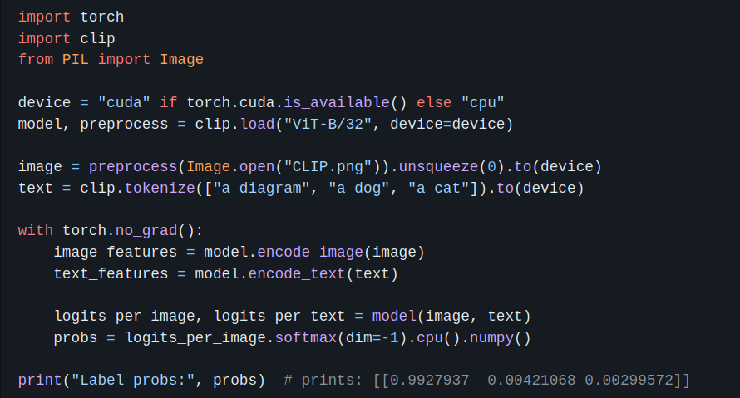
CLIP: Implementation
The official CLIP repository from OpenAI provides a robust implementation of CLIP, along with a wide variety of pretrained models.

Slide 18
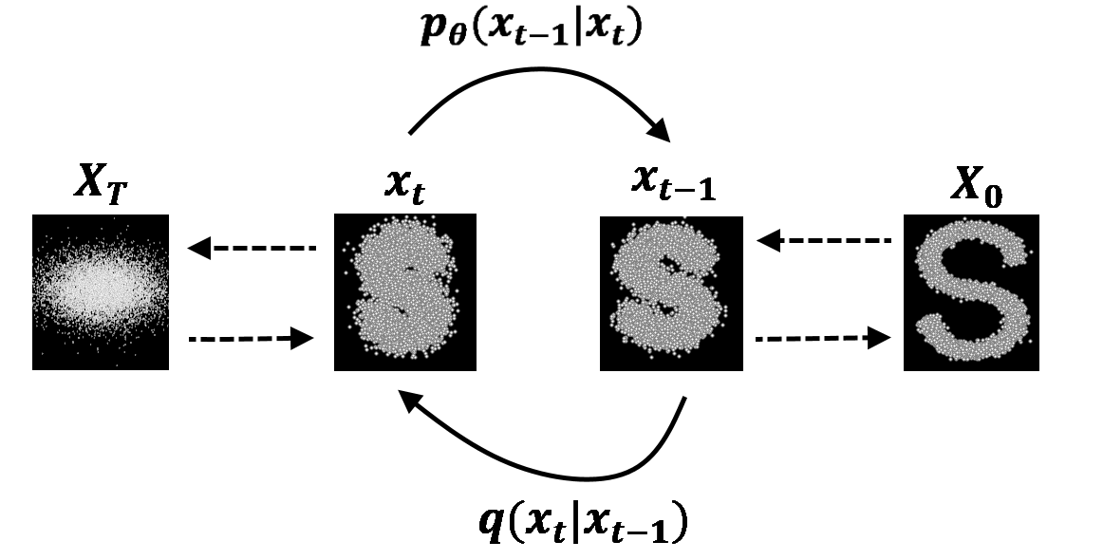
Denoising Diffusion Probabilistic Models
DDPM are a method of generating high-quality samples from a probabilistic model. It involves iteratively refining an initially noisy or low-quality sample by applying a sequence of invertible transformations. This process gradually makes the sample more coherent and realistic.

Slide 19
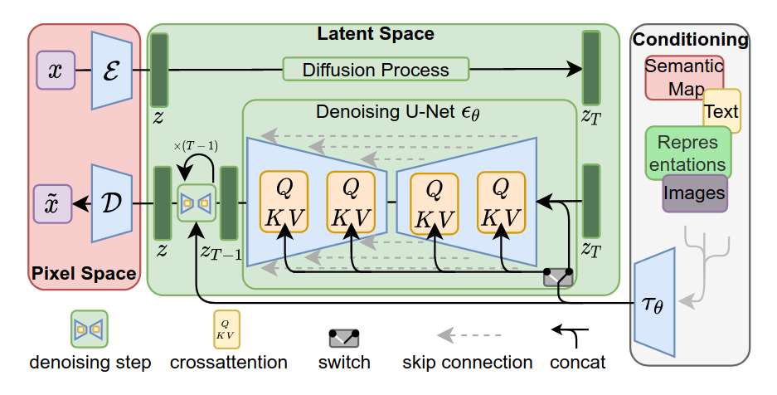
Latent Diffusion
Latent Diffusion is a variant of the diffusion models (DDPM) that operates in the latent space of a generative model.
In this approach, a diffusion process is applied to the latent representations of data, allowing for more efficient generation of high-quality samples.

Slide 20
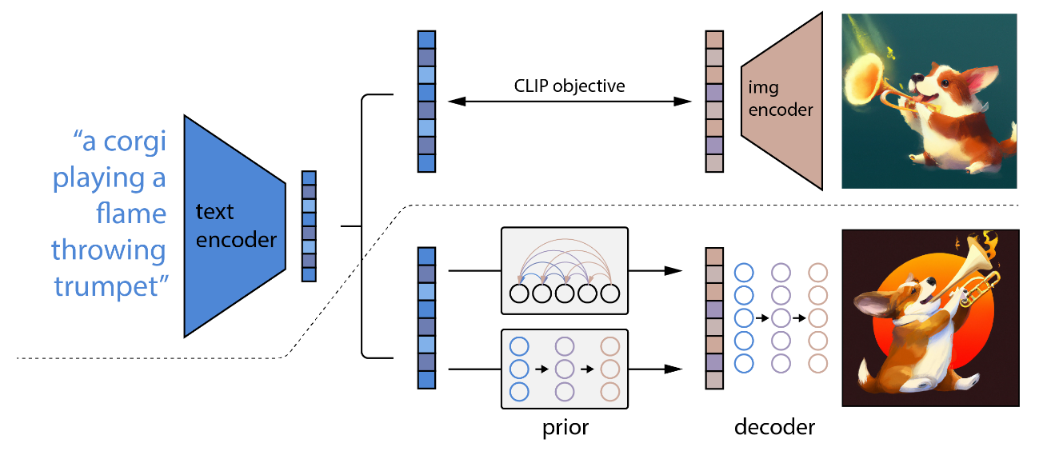
DALLE-2
DALL·E 2 is an advanced version of the DALL·E model by OpenAI, which is a generative model capable of creating images from text descriptions.
It is based on a pretrained CLIP, a diffusion prior and a decoder.

Slide 21
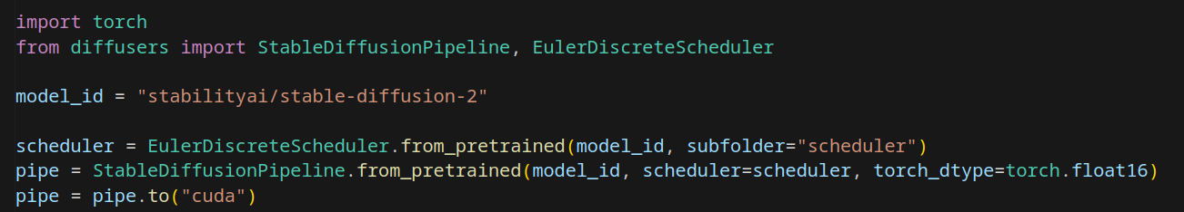

Stable Diffusion: Implementation
Diffusers from Hugging Face offers a comprehensive suite of tools for building and utilizing diffusion models, in addition to providing access to thousands of pretrained models.

Slide 22
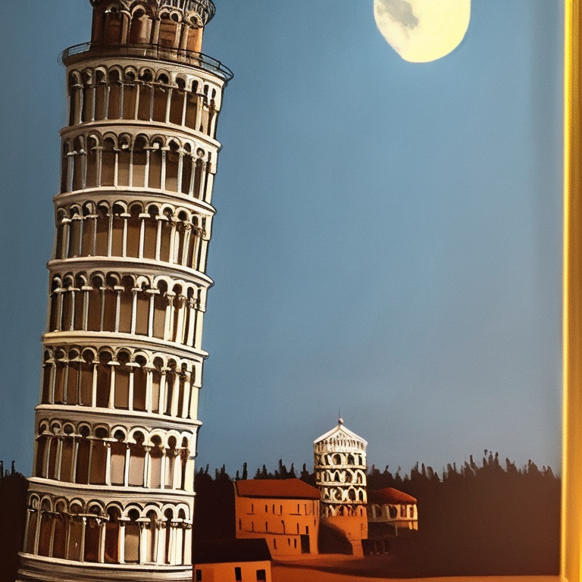
Stable Diffusion: Implementation

Slide 23

Huggingface
French-American company
(we can do AI in Europe)
Hugging Face is a leading organization and platform in the field of natural language processing (NLP) and machine learning. They are known for their contributions to the development and democratization of state-of-the-art NLP models and tools. Hugging Face provides a wide range of open-source libraries and pre-trained models.
Transformers
Hugging Face's Transformers library is a comprehensive framework for working with state-of-the-art natural language processing (NLP) models, including BERT, GPT, and many others. It provides easy access to pretrained models and tools for fine-tuning them on specific NLP tasks.
Diffusers
Hugging Face's Diffusion library is designed for working with diffusion models, which use diffusion processes to generate and denoise data. It offers tools for creating, training, and using diffusion models, making it easier to apply these advanced generative models.
Datasets
Hugging Face's Datasets library is a collection of high-quality, preprocessed datasets for a wide range of NLP and machine learning tasks. It simplifies data loading and preprocessing, making it convenient for researchers and developers to work with diverse datasets.

Slide 24
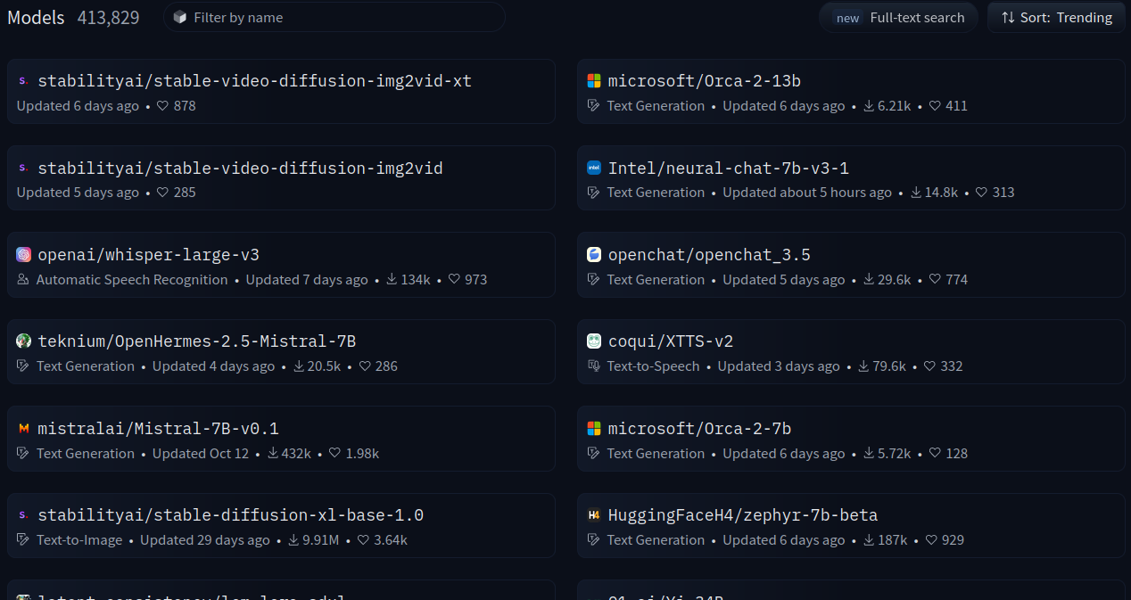
Huggingface: models

Slide 25
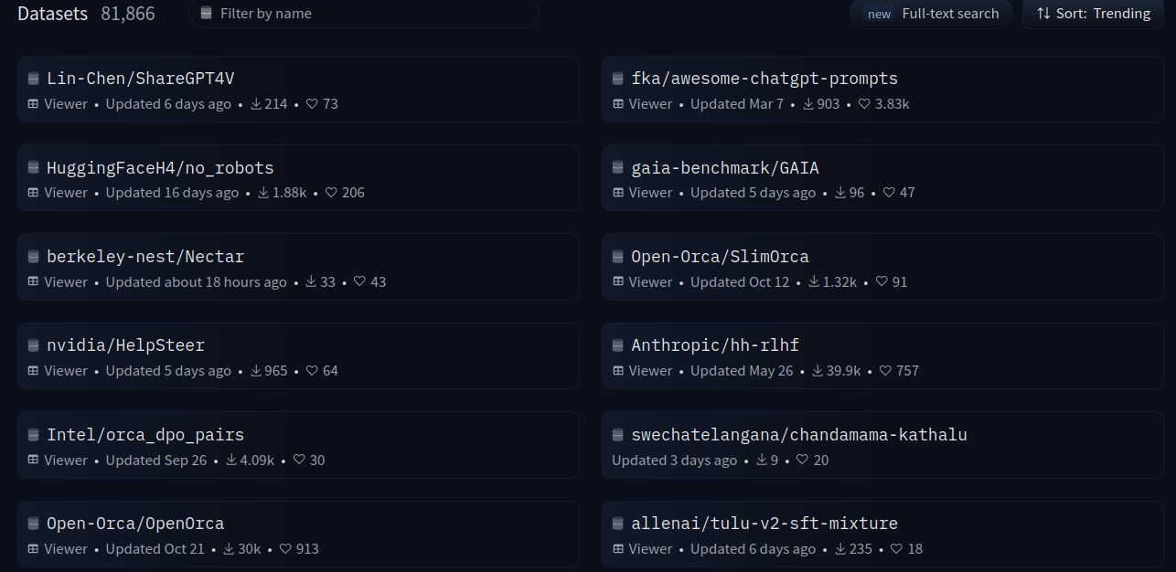
Huggingface: datasets

